Slide 1
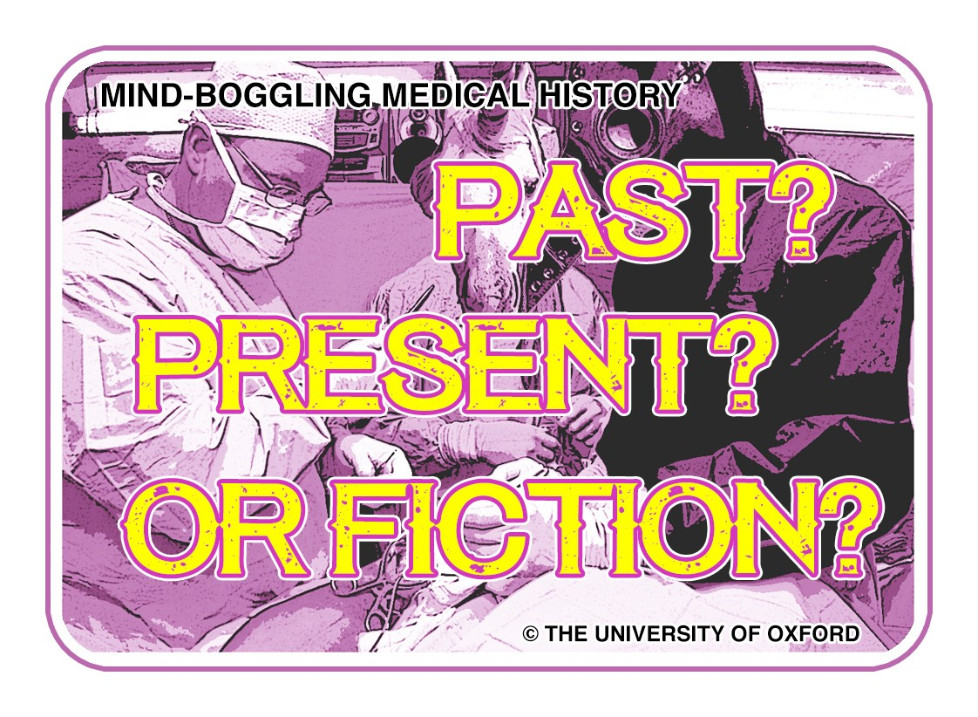
Notes:
Joint project RCN and University of Oxford
Funded by AHRC

Slide 2
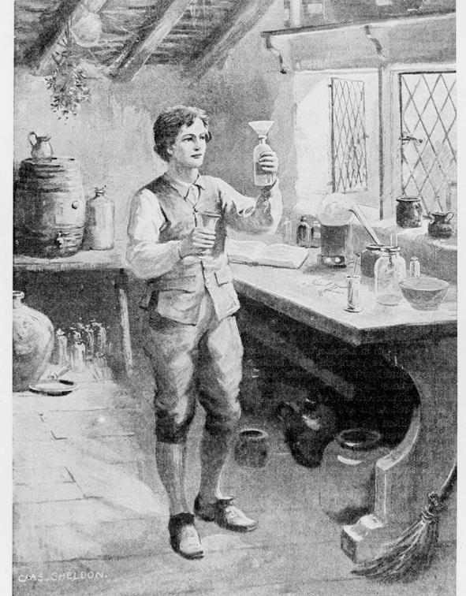
Evidence-based practice…
involves incorporating the most current and valid research results into everyday practice.

Slide 3
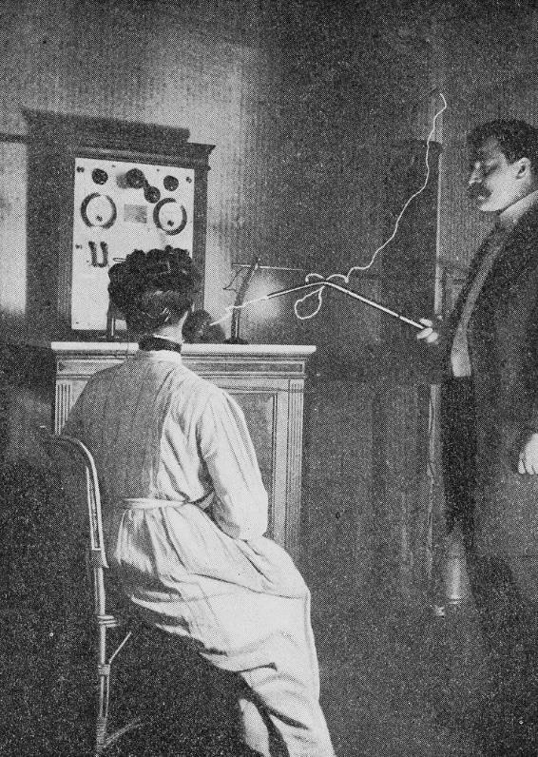
Why is this important?
New evidence is emerging all the time, often revealing more effective treatment options
Can anyone think of a once popular treatment that has now been deemed obsolete by new evidence?
The treatment of malignant tumours by electrical currents ➔
Notes:
Further example: Uusing cola to unclog NG tubes. The acidic nature of many carbonated beverages can potentially damage the feeding tube. They can also make clogging worse by reacting with some enteral formulas. Once a common solution, evidence now suggests it’s safest to use warm water, or change the tube.
Show of hands: who researches every intervention a mentor suggests, with wound care for example? Who at least asks for the rationale for a certain product or treatment option?
Question for brief reflection: How do you determine what is evidence-based and what is hearsay?

Slide 4
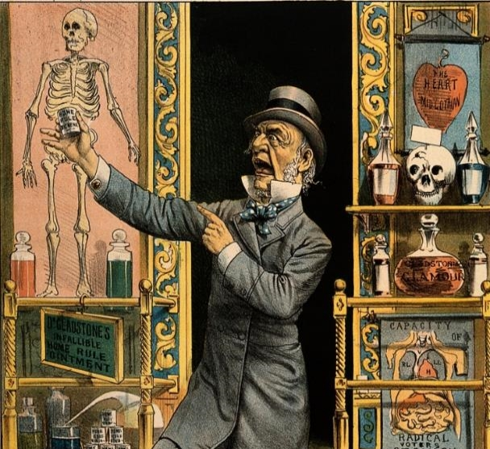
Is each card….
  A current practice?
  A past idea?
  Or completely fictional?
Notes:
Introduce game. Example on next slide.

Slide 5
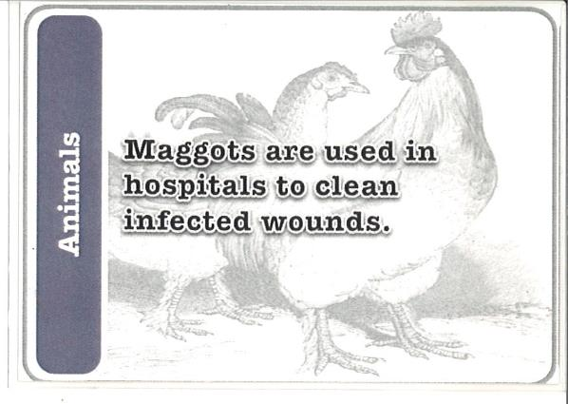
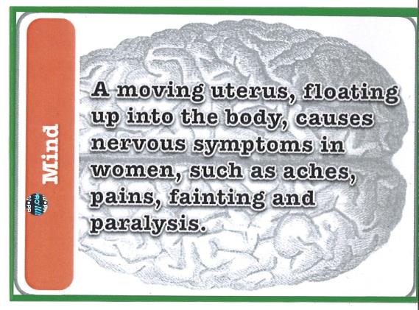
SOLUTIONS
PRESENT!
PAST!
Notes:
Two (easier!) examples to try as a group. Shout out answers.
‘Maggot therapy’ has been popular throughout history, and is still frequently used today in the NHS as a non-surgical alternative for removing build-up of gangrenous tissue.
The Wandering Womb was a popular theory in Ancient Greek medicine, and continued to hold sway for centuries. It was assumed that the symptoms were related to the location of the womb – an unexplained choking sensation, for example, meant it had moved up as far as the throat.

Slide 6
Is each card….
  A current practice?
  A past idea?
  Or completely fictional?
Notes:
Now your turn: In groups debate and decide whether the statements are past, present or fictional treatments. Internet = cheating!

Slide 7
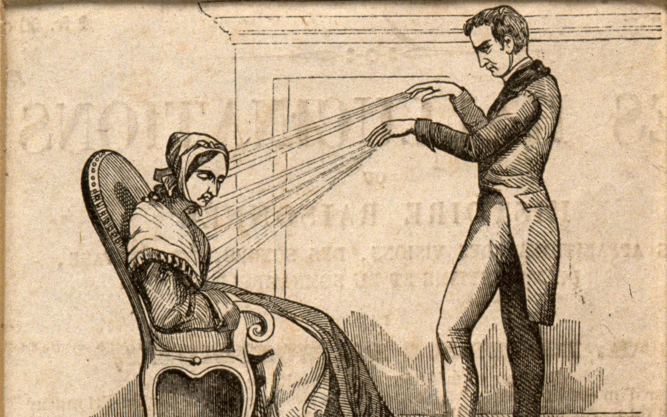
ANSWERS!

Slide 8
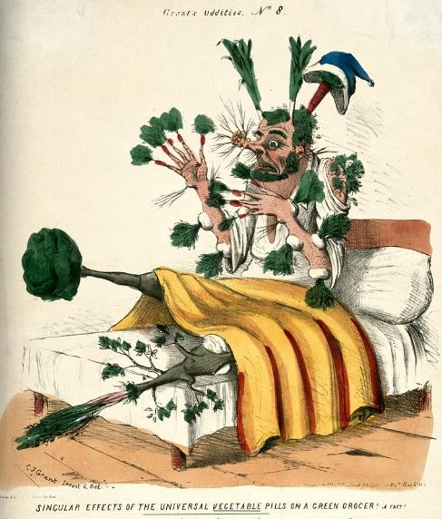
FICTIONAL
1. In the absence of medical supplies, butter can be pasted around the edges of a wound to prevent bacteria from entering it.
2. The tailbone (coccyx) can be manipulated to make a person taller.
3. If used wrongly, the universal antibiotic Kalocin can kill off all good bacteria in a person’s body, risking an infinite number of infections.
Notes:
Although commercially produced butter has a long shelf-life as it’s made from pasteurised milk, like other foods it can go off. If left exposed, the butter will start to go mouldy. Putting food products on wounds is very unhygienic and likely to cause infection. To keep bacteria away, it’s much better to keep the wound as clean as possible through regular washing. Eating certain foods can promote healing, by ensuring the body has plenty of essential nutrients. For example, sweet potatoes are a rich source of Vitamins C, useful for the formation of scar tissue.
The coccyx is a small triangular section of bone at the very bottom of the spine, consisting of three to five bones joined together by ligaments. Commonly termed ‘tailbone’, it is thought to be left over from when humans had a tail during an earlier stage of evolution. The position of the coccyx has no bearing on how tall a person is, and in fact has a limited range of movement. However, it is useful in providing balance when sitting, and also in supporting the pelvic floor muscles and important ligaments which stretch along the spine.
Kalocin is a fictional drug from the novel The Andromeda Strain (1969). In the novel, the drug is a universal treatment for every known type of virus or bacterium. Unfortunately, if a person stopped taking the drug, they quickly died from superinfection caused by the medicine having depleted their body’s normal microbes. Whilst Kalocin and its effects are fictional, antibiotic resistance is a very real problem, described by the World Health Organisation (WHO) as ‘one of the biggest threats to global health today.’ Antibiotic resistance occurs when bacteria change in response to such medications, developing into strains which become harder to treat. This means that even common illnesses or small injuries become dangerous, and can once again kill. One of the major causes of this is the overuse of antibiotics, and WHO advises to take them only when necessary and prescribed by a healthcare professional.

Slide 10
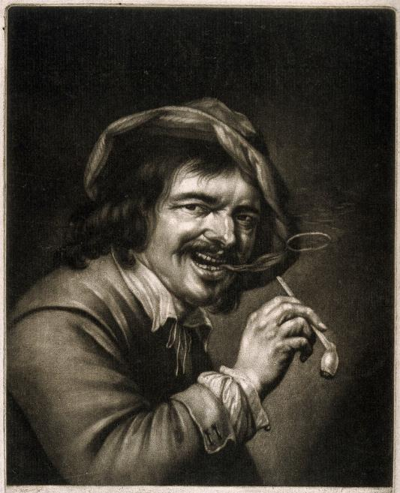
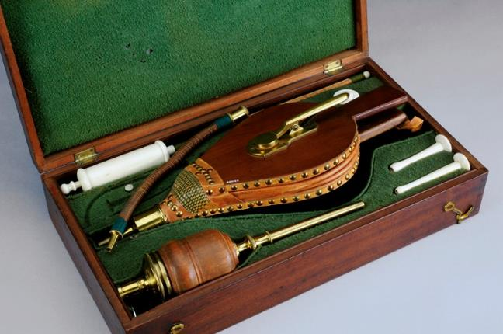
1. Blowing tobacco smoke into the anus of a semi-conscious person will revive them.
Notes:
The tobacco enema was a popular method of reviving people pulled from the river Thames in the late eighteenth century. In 1774, two London doctors formed The Society for the Recovery of Persons Apparently Dead From Drowning (later renamed to the catchier Royal Humane Society). The Society paid money to anyone who successfully revived a seemingly drowned person, and placed tobacco resuscitation kits at strategic points along the Thames. At the time, it was believed that some of the best treatments for drowning were warmth and the administration of stimulating vapours, which would prompt respiration. As the drowned person obviously couldn’t inhale the smoke, it was thought the next best thing was to blow it up their bum!
Image left: tobacco resuscitation set (1801-1850)

Slide 11
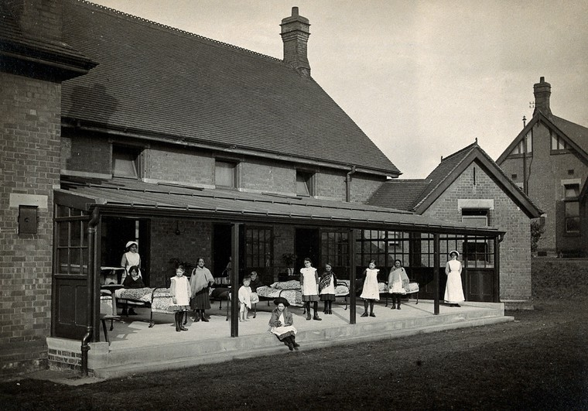
2. Hospitals place beds outside in all weathers to help ease symptoms of tuberculosis (TB)
Notes:
It’s difficult for us today to imagine the impact tuberculosis had on society. Many thousands suffered from the debilitating lung disease which required many months of treatment and which was frequently fatal. In the late nineteenth and early twentieth centuries large sanatoriums were set up to treat patients. Fresh air was seen as one of the best forms of prevention and cure for TB, and sanatoria patients would often have their beds moved outside where they would spend the majority of the day taking in the air, even in snow. While fresh air and a healthy lifestyle might mitigate some of the pain and discomfort of TB symptoms, it did not address the bacterial cause of the disease. This would only be tackled with antibiotics later in the century.

Slide 12
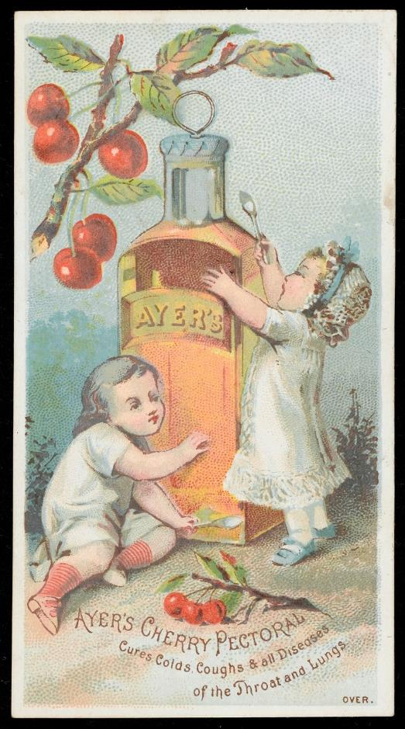
Heroin is a non-addictive alternative for morphine used in cough medicine.
Notes:
It might be hard to believe but at the beginning of the twentieth century heroin was sold as a medicine to treat coughs! The prevalence of infectious diseases like tuberculosis meant that many people suffered from severe coughs and desperately sought help to cure the ailment. Other opiates like morphine or laudanum were already commonly used as cough suppressants, but were considered imperfect because they could lead to addiction. Heroin was produced, commercialised and sold by the German pharmaceutical company Bayer as it was thought to be a non-addictive alternative, and in 1906 the American Medical Association approved its use. As you might expect, reports soon flooded in that users quickly became hooked on the new substance. The drug became illegal in America and Britain in the 1920s.

Slide 13
THE WHAT,
WHY, HOW OF
PUBLIC ENGAGEMENT

Slide 14
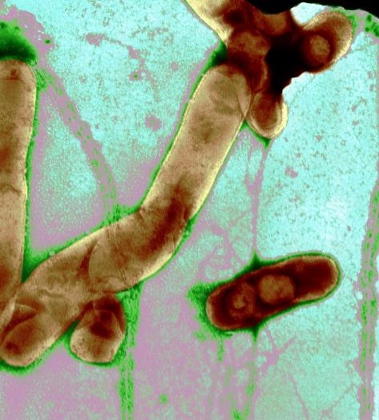
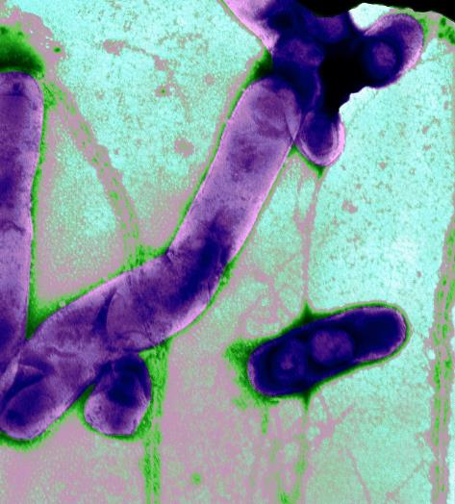
Faeces from healthy people mixed with water is given to treat patients suffering from intestinal infection.
Notes:
As unpleasant as this might sound, it’s actually an effective way to treat bacterial infection, colitis, irritable bowel syndrome, and constipation. The procedure is called Faecal Microbiota Transplantation (FMT), and involves restoration of the colonic flora by introducing healthy bacterial flora from a human donor. This is done through a stool and warm water infusion. But don’t worry, the patient doesn’t have to drink it! The stool and water mixture is delivered either by nasal or rectal tube straight to the colon. The benefits of FMT are that it is low-cost, and can be life-saving for patients with debilitating intestinal infections.

Slide 15
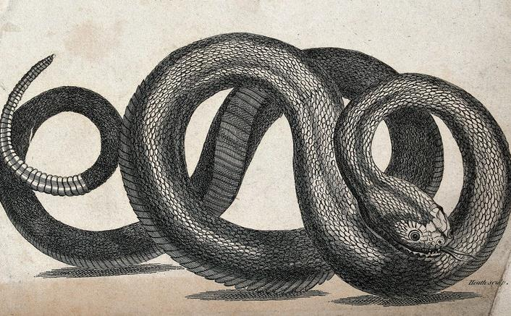
Snake venom is used to fight cancer
Notes:
Snake venom has been used for medicinal purposes in China since at least the 1st century AD, but more recently scientists have found evidence for its effectiveness in inhibiting the growth of cancer cells. Snake venoms have a high toxicity potential, which means that they are useful in the development of anticancer agents. New technologies mean that biotoxins can be extracted from the venom, and once isolated, used to prevent cancerous cells from adhering together and interacting with surrounding tissue. This is particularly important in stopping or slowing the spread of tumours.

Slide 16
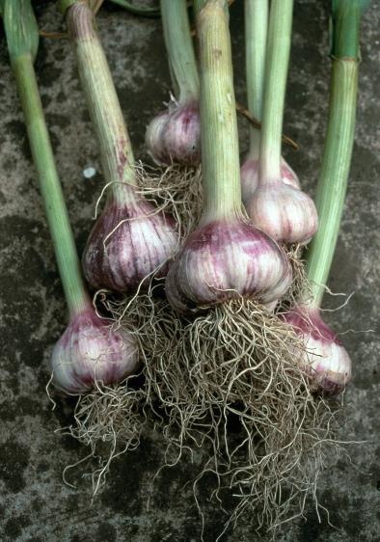
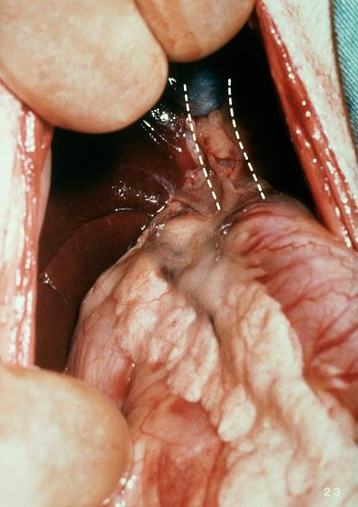
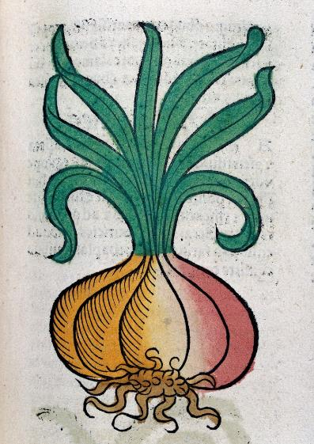
A combination of onion, garlic and cow bile can help kill infections
Notes:
In 2015 collaborative research between scientists and academics working in Viking Studies found that an Anglo-Saxon remedy for eye infections containing onion, garlic and cow bile was able to kill about 90% of MRSA bacteria in testing. The Old English recipe stated that one must ‘take cropleek and garlic, of both equal quantities,’ then add ‘wine and bullocks gall,’ before letting it ‘stand nine days in the brass vessel.’ It sounds a bit like a witch’s brew, and in fact using exactly the right method was crucial, as the potion failed to kill the bacteria if prepared in a slightly different way. This research could potentially lead to the development of new drugs which might help to combat antibiotic-resistant infections.

Slide 17
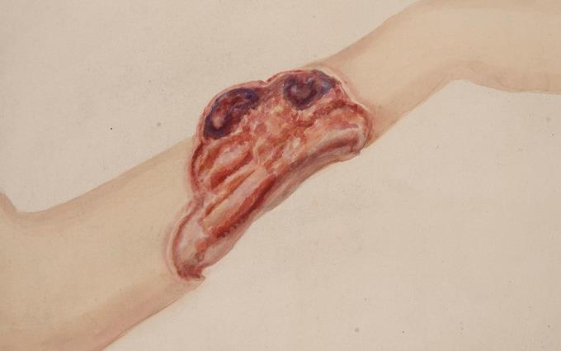
Silver dressings are a good treatment for chronic ulcers and extensive burns
Notes:
Silver has long been used for medical purposes, particularly due to its antimicrobial properties which makes it useful as an aid in fighting off infection. In the past, surgical incisions were often sewn up using silver surgical sutures, and silver is still used today as a wound dressing. Silver ointments or creams are often used in burns management, or to treat chronic ulcers. Whilst some new evidence has questioned whether the metal is necessarily better than other types of treatment for wounds, the continued use of silver could have an important role to play in the fight against antibiotic resistance. This is because topical antiseptics like silver have a low risk of bacteria developing resistance to it.

Slide 18
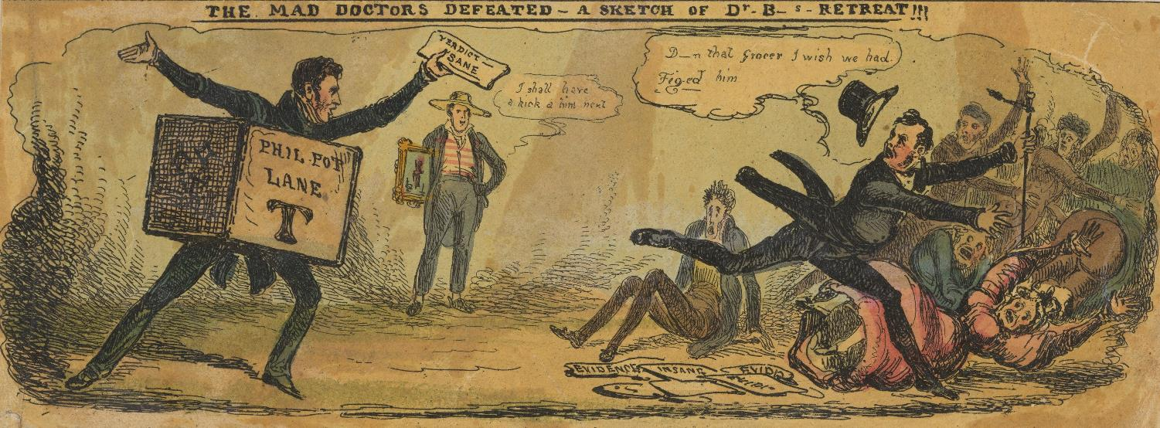
HOW DID YOU DO?
Notes:
Which answers are most surprising?
Suggested question to group: Do you think you will be more conscientious in future when considering how a treatment option came about?

Slide 19
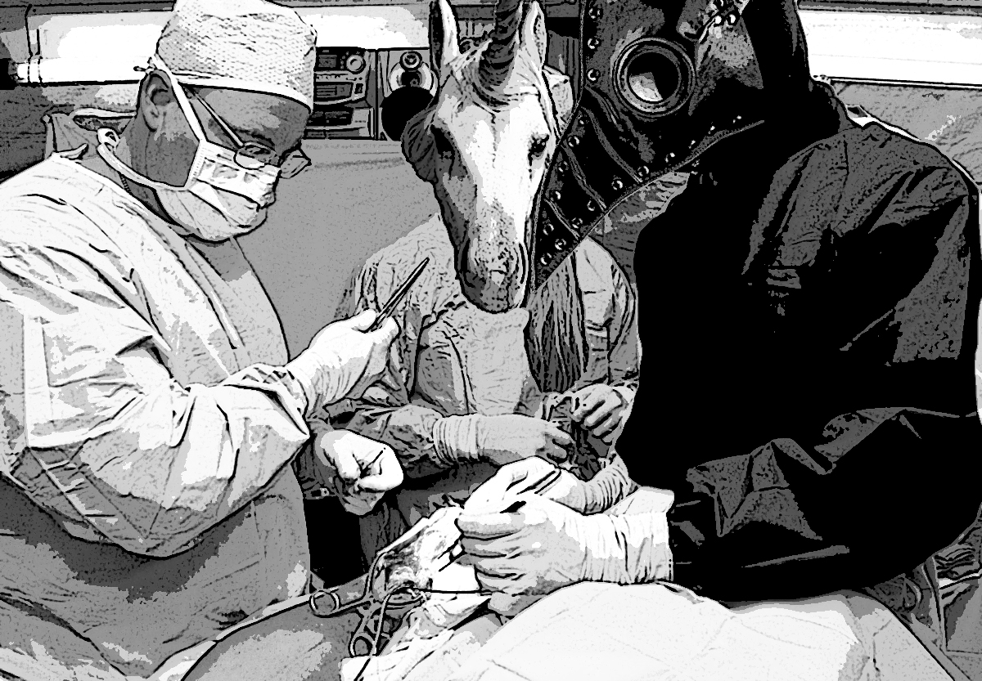
Thank you

Slide 20
'Humphrey Davy making his first experiment when a boy.’
'The treatment of malignant tumours by electrical currents.’
'A quack doctor selling remedies from his caravan; satirizing' by Tom Merry
'A practictioner of Mesmerism using Animal Magnetism’
'Nottingham: open air treatment of sick children.’
'Head and shoulders of a man holding a tobacco pipe and blowing a smoke ring. Mezzotint, mid-17th century, by A. B.’
'Resuscitation set, Europe, 1801-1850' by Science Museum, London
'Two babies with giant bottle of Ayers Cherry Pectoral’
'Intestinal bacteria' by University of Edinburgh
'A wood rattle-snake. Etching by Heath.’
'Allium sativum (Garlic)' by Rowan McOnegal
'An onion, woodcut, 1547'
'Opened up dog: Close-up: common bile duct' by Royal Veterinary College
'Girl's forearm with a large chronic ulcer' by Mark, Leonard Portal and St Bartholomew's Hospital Archives & Museum
'The mad doctors defeated - a sketch of Dr. B-s retreat!!!' by William Heath
All images from Wellcome Collection (in order of use):

