Slide 1
Mind-Boggling Medical History
Mind – GCSE

Slide 2
 |  | Activity | Timings | Extension(s)
1 | Do now / starter | Match up the medical term to the definition | 5 | Challenge: a number of celebrities have been vocal about the importance of opening discussion around mental health – what do you know about mental health?
2 | I do (explain) | Mind-boggling medical history – sorting the treatments into ‘present’, ‘Past’ and completely ‘fictional’. | 5
3 | You do (paired/group/whole class) | Your choice: can be printed and sorted in pairs/small groups, or on the board and discussed as a class. | 10-15 | Challenge: students must justify their response(s) with logic and/or prior knowledge (e.g. I believe this is current practice because I read about someone with… or, this seems logically sound because garlic is supposed to be good for you, etc.)
4 | We do (discussion) | Teacher reads the information as each statement is revealed to be present, past, or fictional – giving time for students to respond/query any that surprise them. | 10-15
5 OR | You do (task – reading, summarising and explaining) | Understand current stance on mental health – option to watch the video. Read article on PHRENOLOGY and CRIME Summarise and/or explain the changes in approaches to mental health and crime. | 10-20
6 | You do (task – reading, summarising and explaining) | Understand current stance on mental health – option to watch the video. Read article on WOMEN and HYSTERIA Summarise and/or explain the changes in approaches to mental health and women. | 10-20
7 | Plenary | To complete the questionnaire and write down which fact surprised them the most and why. | 5
Timings are flexible where needed
e.g.
30 mins – 1, 2, 3, 4
40 mins – 1, 2, 3, 4, 6
60 mins – 1, 2, 3, 4, 5, 7

Slide 3

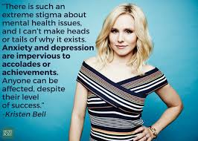
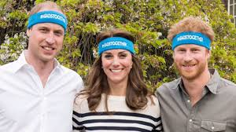
Do now: match the key term to the definition on your sheet.
Challenge: A number of celebrities have been vocal recently about the importance of opening discussion around mental health – what do you know about mental health already?

Slide 4
Mind-boggling Medical History: Mind
Key term
Symptoms
Uterus
Emotional shock
Irregular
Proportion
Severe depression
Psychosis
Smelling salts
Impaired judgement
Manic
Definition
Not even or balanced in timing
A severely distressing event, e.g. death of a loved one, a car accident, etc.
A physical or mental sign, indicating the presence of a disease
A severe mental disorder where a person interprets reality differently from those around them.
Chemical compounds often used to wake people up who have fainted.
An organ in the lower body of a female where offspring are conceived; the womb.
Mental difficulty affecting your ability to make rational choices.
A part of share in relation to the whole (e.g. 10% of the population)
Mental illness marked by periods of great excitement, delusions, and overactivity.
A mental disorder involving consistent low mood, often accompanied by low self-esteem and low energy.

Slide 5
Glossary of medical terms – match up
Key term
Symptoms
Uterus
Emotional shocks
Irregular
Proportion
Severe depression
Psychosis
Smelling salts
Impaired judgement
Manic
Definition
Not even or balanced in timing
A severely distressing event, e.g. death of a loved one, a car accident, etc.
A physical or mental sign, indicating the presence of a disease
A severe mental disorder where a person interprets reality differently from those around them.
Chemical compounds often used to wake people up who have fainted.
An organ in the lower body of a female where offspring are conceived; the womb.
Mental difficulty affecting your ability to make rational choices.
A part of share in relation to the whole (e.g. 10% of the population)
Mental illness marked by periods of great excitement, delusions, and overactivity.
A mental disorder involving consistent low mood, often accompanied by low self-esteem and low energy.

Slide 6
Over to you…
Present | Past | Fictional
The theory or practice is from modern-day medicine. It is believed to be true by most medical and healthcare practitioners or is in current use today. | The theory or practice is from the history of medicine. It was once believed to be true by some or all medical and healthcare practitioners. It is now thought to be factually incorrect or is no longer in use. | The theory or practice is entirely made up. As far as we know no-one has ever believed this theory or used this treatment.
Sort the different treatments into the 3 categories.
Do you think it is still being used (present)?
Or was once used in the past?
Or is utterly made up (fictional)?
Challenge: be ready to justify your answers!

Slide 7
Present | Past | Fictional
Shaving the head is important in the treatment of psychosis as it allows the patient's brain to cool, thus reducing manic symptoms associated with overheating.
Electricity currents passed through the brain can reduce the symptoms of severe depression.
A moving uterus, floating up into the body, causes nervous symptoms in women, such as aches, pains, fainting and paralysis.
Emotional shocks can be fatal.
A small proportion of the population can survive without an oxygen supply to the brain.
Women have smaller brains than men.
Irregular periods can cause insanity in women.
Every part of your personality is due to a particular part of the brain. The more you have that trait, the bigger that part of the brain will be.
Mice droppings are used in smelling salts to calm the nerves.
A severe fracture of the spine resulting in injury to the spinal cord can cause memory loss and impaired judgement.

Slide 8
Electricity currents passed through the brain can reduce the symptoms of severe depression.
Irregular periods can cause insanity in women.
Emotional shocks can be fatal.
Women have smaller brains than men
A moving uterus, floating up into the body, causes nervous symptoms in women, such as aches, pains, fainting and paralysis.
Every part of your personality is due to a particular part of the brain. The more you have that trait, the bigger that part of the brain will be.
Shaving the head is important in the treatment of psychosis as it allows the patient's brain to cool, thus reducing manic symptoms associated with overheating
A severe fracture of the spine resulting in injury to the spinal cord can cause memory loss and impaired judgement.
A small proportion of the population can survive without an oxygen supply to the brain.
Mice droppings are used in smelling salts to calm the nerves.

Slide 9

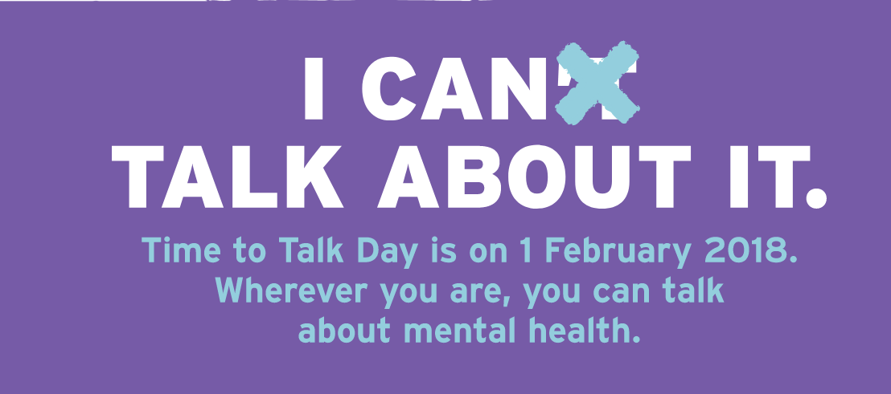
Many charities today promote the idea that mental health should not be a taboo subject.
Princes William and Harry, and the Duchess of Cambridge have all spoken widely of their support for this movement.
https://www.youtube.com/watch?v=WXPx_fBJVPU
“Through our work with young people, emergency response, homeless charities, and with veterans, we have seen time and time again that unresolved mental health problems lie at the heart of some of our greatest social challenges.”
HeadsTogether
https://www.headstogether.org.uk/
Notes:
https://www.youtube.com/watch?v=WXPx_fBJVPU

Slide 10
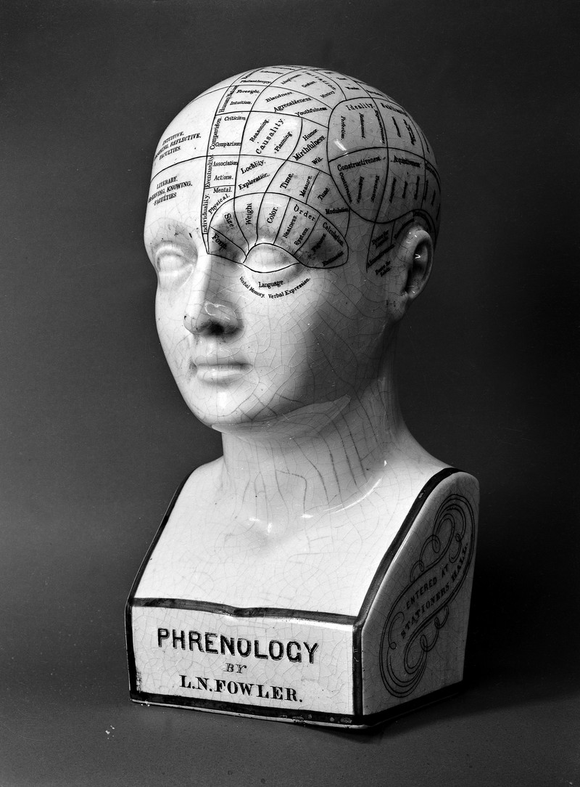
Phrenology
Medical theory put forward by the Austrian doctor Franz Joseph Gall (1758 – 1828).
He viewed the brain as the ‘organ’ of the mind, and thought particular parts of the brain related to certain personality traits, such as self-esteem, cautiousness and kindness.
These areas would be bigger in some people than others, so you could define a personality by measuring the skull. This particularly applied to ‘criminal minds’, and was generally accepted in the Victorian era.

Slide 11
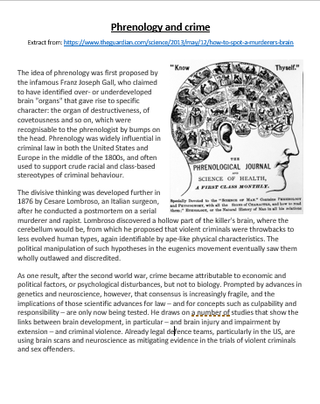
Phrenology
Read the article on phrenology and crime.
With your partner, summarise the key ideas.
On your own, write a paragraph to explain how our ideas about mental health and crime have changed. What could we still aim to change and why?

Slide 12
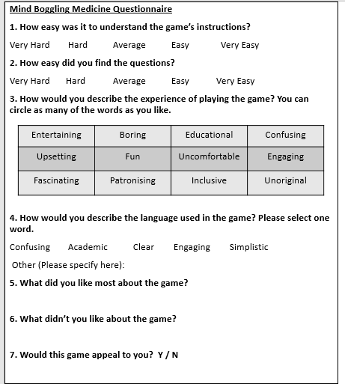
Plenary
Answer the quick questionnaire honestly.
Which fact surprised you the most and why? Write your answer on a post-it note.

Slide 13
OR

Slide 14
Many charities today promote the idea that mental health should not be a taboo subject.
Princes William and Harry, and the Duchess of Cambridge have all spoken widely of their support for this movement.
https://www.youtube.com/watch?v=WXPx_fBJVPU
“Through our work with young people, emergency response, homeless charities, and with veterans, we have seen time and time again that unresolved mental health problems lie at the heart of some of our greatest social challenges.”
HeadsTogether
https://www.headstogether.org.uk/
Notes:
https://www.youtube.com/watch?v=WXPx_fBJVPU

Slide 15
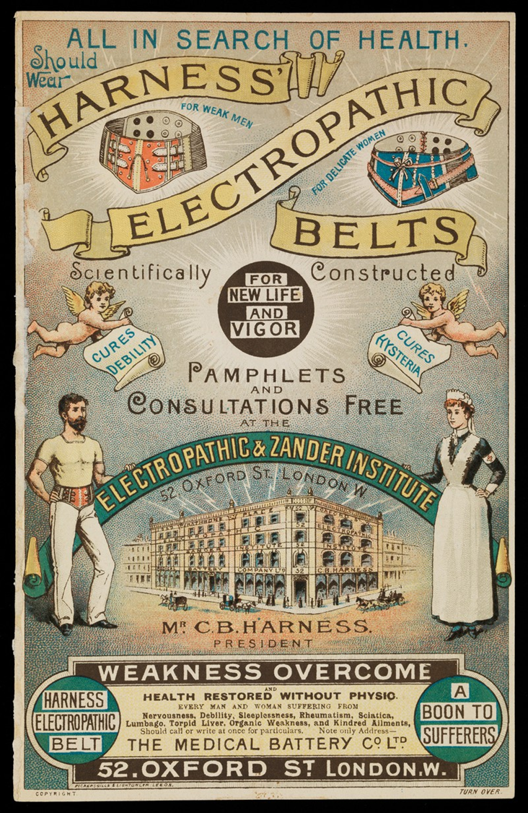
Hysteria
A nervous illness typically associated with women throughout medical history.
The word ‘hysteria’ comes from the Greek word for uterus.
A long list of doctors, from Ancient Egypt to the Victorian era, have attributed a range of symptoms to ‘female hysteria’, from anxiety, fainting and loss of interest/increased interest in sex.

Slide 16
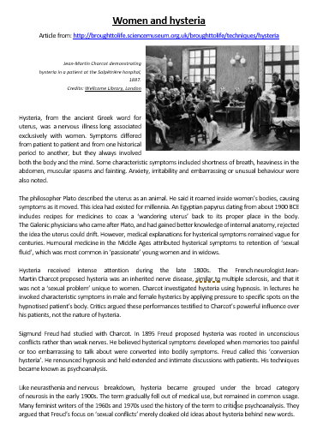
Hysteria
Read the article on women and hysteria.
With your partner, summarise the key ideas.
On your own, write a paragraph to explain how our ideas about mental health and women have changed. What could we still aim to change and why?

Slide 17
Plenary
Answer the quick questionnaire honestly.
Which fact surprised you the most and why? Write your answer on a post-it note.

Slide 18
Additional reading
https://www.mentalhealth.org.uk/a-to-z/w/women-and-mental-health
https://www.mentalhealth.org.uk/statistics/mental-health-statistics-men-and-women
http://broughttolife.sciencemuseum.org.uk/broughttolife/techniques/hysteria
http://www.albany.edu/museum/wwwmuseum/criminal/curator/nicole.html
https://www.theguardian.com/science/2013/may/12/how-to-spot-a-murderers-brain
https://www.time-to-change.org.uk/
https://www.headstogether.org.uk/

Slide 20
Resources

Slide 21
Mind-boggling Medical History: Mind
Key term
Symptoms
Uterus
Emotional shock
Irregular
Proportion
Severe depression
Psychosis
Sniffing salts
Impaired judgement
Manic
Definition
Not even or balanced in timing
A severely distressing event, e.g. death of a loved one, a car accident, etc.
A physical or mental sign, indicating the presence of a disease
A severe mental disorder where a person interprets reality differently from those around them.
Chemical compounds often used to wake people up who have fainted.
An organ in the lower body of a female where offspring are conceived; the womb.
Mental difficulty affecting your ability to make rational choices.
A part of share in relation to the whole (e.g. 10% of the population)
Mental illness marked by periods of great excitement, delusions, and overactivity.
A mental disorder involving consistent low mood, often accompanied by low self-esteem and low energy.

Slide 22
Glossary of medical terms – match up
Key term
Symptoms
Uterus
Emotional shocks
Irregular
Proportion
Severe depression
Psychosis
Sniffing salts
Impaired judgement
Manic
Definition
Not even or balanced in timing
A severely distressing event, e.g. death of a loved one, a car accident, etc.
A physical or mental sign, indicating the presence of a disease
A severe mental disorder where a person interprets reality differently from those around them.
Chemical compounds often used to wake people up who have fainted.
An organ in the lower body of a female where offspring are conceived; the womb.
Mental difficulty affecting your ability to make rational choices.
A part of share in relation to the whole (e.g. 10% of the population)
Mental illness marked by periods of great excitement, delusions, and overactivity.
A mental disorder involving consistent low mood, often accompanied by low self-esteem and low energy.

Slide 23
Electricity currents passed through the brain can reduce the symptoms of severe depression.
Irregular periods can cause insanity in women.
Emotional shocks can be fatal.
Women have smaller brains than men
A moving uterus, floating up into the body, causes nervous symptoms in women, such as aches, pains, fainting and paralysis.
Every part of your personality is due to a particular part of the brain. The more you have that trait, the bigger that part of the brain will be.
Shaving the head is important in the treatment of psychosis as it allows the patient's brain to cool, thus reducing manic symptoms associated with overheating
A severe fracture of the spine resulting in injury to the spinal cord can cause memory loss and impaired judgement.
A small proportion of the population can survive without an oxygen supply to the brain.
Mice droppings are used in sniffing salts to calm the nerves.

Slide 24
Present | Past | Fictional

Slide 25
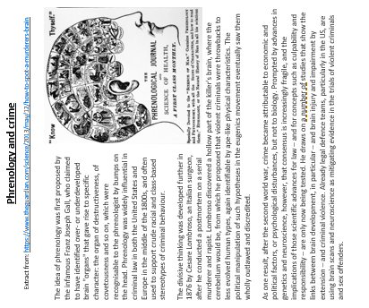

Slide 26


Slide 27
Mind Boggling Medicine Questionnaire
1. How easy was it to understand the game’s instructions?
Very Hard Hard Average Easy Very Easy
2. How easy did you find the questions?
Very Hard Hard Average Easy Very Easy
3. How would you describe the experience of playing the game? You can circle as many of the words as you like.
4. How would you describe the language used in the game? Please select one word.
Confusing Academic Clear Engaging Simplistic
Other (Please specify here):
5. What did you like most about the game?
6. What didn’t you like about the game?
7. Would this game appeal to you? Y / N
Mind Boggling Medicine Questionnaire
1. How easy was it to understand the game’s instructions?
Very Hard Hard Average Easy Very Easy
2. How easy did you find the questions?
Very Hard Hard Average Easy Very Easy
3. How would you describe the experience of playing the game? You can circle as many of the words as you like.
4. How would you describe the language used in the game? Please select one word.
Confusing Academic Clear Engaging Simplistic
Other (Please specify here):
5. What did you like most about the game?
6. What didn’t you like about the game?
7. Would this game appeal to you? Y / N
Entertaining | Boring | Educational | Confusing
Upsetting | Fun | Uncomfortable | Engaging
Fascinating | Patronising | Inclusive | Unoriginal
Entertaining | Boring | Educational | Confusing
Upsetting | Fun | Uncomfortable | Engaging
Fascinating | Patronising | Inclusive | Unoriginal

