Slide 1
Mind-Boggling Medical History
Animals – GCSE

Slide 2
 |  | Activity | Timings | Extension(s)
1 | Do now / starter | Match up the medical term to the definition | 5 | Challenge: What could connect all of these images?
2 | I do (explain) | Mind-boggling medical history – sorting the treatments into ‘Present’, ‘Past’ and completely ‘fictional’. | 5
3 | You do (paired/group/whole class) | Your choice: can be printed and sorted in pairs/small groups, or on the board and discussed as a class. | 10-15 | Challenge: students must justify their response(s) with logic and/or prior knowledge (e.g. I believe this is current practice because I read about someone with… or, this seems logically sound because garlic is supposed to be good for you, etc.)
4 | We do (discussion) | Teacher reads the information as each statement is revealed to be current, disproved or fictional – giving time for students to respond/query any that surprise them. | 10-15
5 OR | You do (task – think, pair, share followed by evaluative essay) | Debate topic of animal testing for medical purposes, to discuss and use statistics to then complete an evaluative, balanced essay (could be completed as a homework) | 5, 20 (25)
6 | You do (task – look at the 2 sources and explain) | Use the 2 sources to explain the use of leeches in medical history. | 10 | Challenge: Why do some medical treatments, like using leeches, come back into usage? Discuss.
7 | Plenary | To complete the questionnaire and write down which fact surprised them the most and why. | 5
Timings are flexible where needed
e.g.
30 mins – 1, 2, 3, 4
40 mins – 1, 2, 3, 4, 6
60 mins – 1, 2, 3, 4, 5, 7

Slide 3
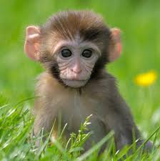
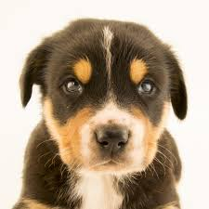
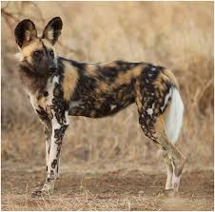
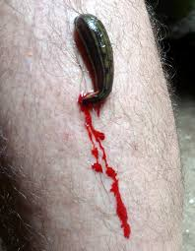
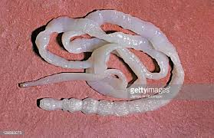
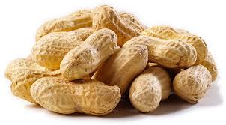
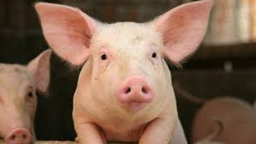
Do now: match the key term to the definition on your sheet.
Challenge: What could connect all of these images?
Notes:
Monkey, puppy, Wild Dog, leeches, peanuts, tapeworm, pigs,

Slide 4
Mind-boggling Medical History: Animals
Key term
Infect
Laboratory
Detect
Nut allergy sufferers
Leeches
Soft tissue
Detaching
Reconstructive
Maggots
Rabies
Wild Dogs
Valves
Tapeworms
Tranquilizers
Therapeutically
Definition
To unfasten, or disconnect something, and remove it.
Someone who has a (possibly life threatening) allergy to nuts/peanuts.
Body tissues that are not hardened, e.g. blood vessels, skin, muscles, etc.
A contagious and fatal disease found in dogs, causing madness and convulsions.
A room or building equipped for scientific experiments or research.
A wild member of the dog family, usually found in Africa, India or Australia.
Affect with a harmful or disease-causing organism.
To discover, or identify, the presence of something.
A flat worm that feeds off its host, lives in the intestines.
A worm with suckers at both ends. Many species are bloodsucking parasites.
Relating to the healing of a disease/ailment.
A medical drug taken to reduce anxiety, e.g. sedative.
Rebuilding something after it has been damaged or destroyed.
A tube in the heart that only allows blood to flow in one direction
A soft-bodied larva of a fly or other insect, found in decaying matter.

Slide 5
Glossary of medical terms – match up
Key term
Infect
Laboratory
Detect
Nut allergy sufferers
Leeches
Soft tissue
Detaching
Reconstructive
Maggots
Rabies
Wild Dogs
Valves
Tapeworms
Tranquilizers
Therapeutically
Definition
To unfasten, or disconnect something, and remove it.
Someone who has a (possibly life threatening) allergy to nuts/peanuts.
Body tissues that are not hardened, e.g. blood vessels, skin, muscles, etc.
A contagious and fatal disease found in dogs, causing madness and convulsions.
A room or building equipped for scientific experiments or research.
A wild member of the dog family, usually found in Africa, India or Australia.
Affect with a harmful or disease-causing organism.
To discover, or identify, the presence of something.
A flat worm that feeds off its host, lives in the intestines.
A worm with suckers at both ends. Many species are bloodsucking parasites.
Relating to the healing of a disease/ailment.
A medical drug taken to reduce anxiety, e.g. sedative.
Rebuilding something after it has been damaged or destroyed.
A tube in the heart that only allows blood to flow in one direction
A soft-bodied larva of a fly or other insect, found in decaying matter.

Slide 6
Over to you…
Present | Past | Fictional
The theory or practice is from modern-day medicine. It is believed to be true by most medical and healthcare practitioners or is in current use today. | The theory or practice is from the history of medicine. It was once believed to be true by some or all medical and healthcare practitioners. It is now thought to be factually incorrect or is no longer in use. | The theory or practice is entirely made up. As far as we know no-one has ever believed this theory or used this treatment.
Sort the different treatments into the 3 categories.
Do you think it is still being used (present)?
Or was once used in the past?
Or is utterly made up (fictional)?
Challenge: be ready to justify your answers!

Slide 7
Present | Past | Fictional
Rabies is a mental condition caused by fear of wild dogs.
Pig valves are commonly used in heart valve replacement due to the colour of the tissue. The pink-tinged valve is less likely to be rejected due to the similarity to human valves.
Maggots are used in hospitals to clean infected wounds.
If a pregnant woman is scared by a wild dog it may cause her child to be born with excess hair.
Leeches are used to prevent soft tissue from detaching from the face in reconstructive facial surgery.
Pregnancy can be detected by injecting a woman’s urine into a frog or toad.
Tapeworms can be used to deliver tranquilizers speedily into the body.
Dogs can smell the level of sugar in your blood.
Cats are used therapeutically to detect cancerous growths
Humans can be infected with monkeypox, a disease first discovered in laboratory monkeys.

Slide 8
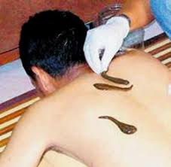
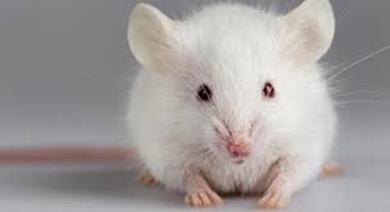
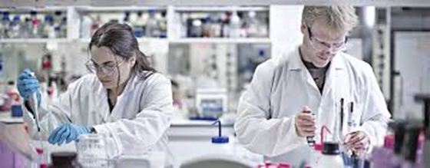
Think, pair, share.
Debate
“Using animals in medical science is wrong.” Discuss.
For (agree) | Against (disagree)
Come up with 1 argument for each side on your own, then share your ideas with your partner. How many arguments can you come up with?
Notes:
For:
Moral implications – they can’t agree/give consent
They feel pain
We have learnt enough from animal testing
Causes unnecessary pain/death
Some testing is cosmetic/unnecessary
etc.
Against:
Huge leaps in life-saving care – e.g. cancer research
Can save human lives
Some do not harm the animals – e.g. leeches

Slide 9
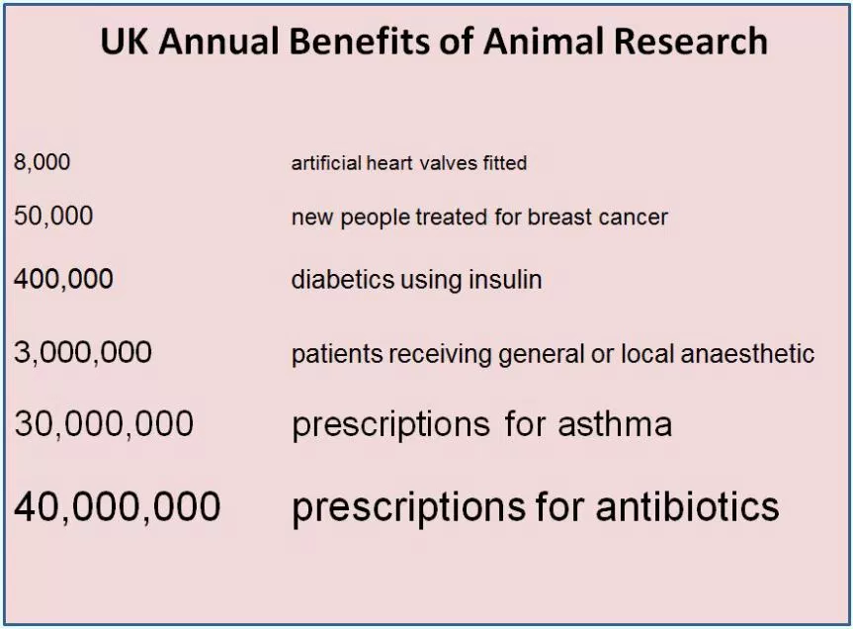
Over to you…
It should include:
Both sides to the debate
A thoughtful, considered approach to the topic
A conclusion explaining which side of the debate you ultimately agree with and why.
Task: Use your arguments to write a balanced, evaluative essay.
Statistics you might use:
Approx. 115 million animals are used in experiments worldwide each year.
in many parts of the world animal experiments are on the increase (e.g. China) or remain at the same level as they were in the 1980/90s(e.g. the UK, Europe).
The vast majority of animal research is not testing drugs but doing basic research and producing genetically modified mice.
Half of all animal experiments are now conducted at universities.
Tip:
These procedures were developed through animal testing and save lives.

Slide 10
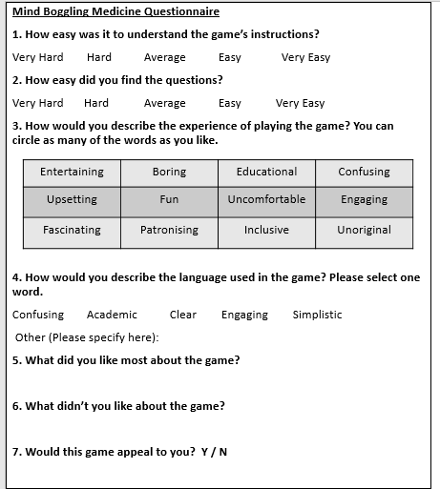
Plenary
Answer the quick questionnaire honestly.
Which fact surprised you the most and why? Write your answer on a post-it note.

Slide 11
OR

Slide 12
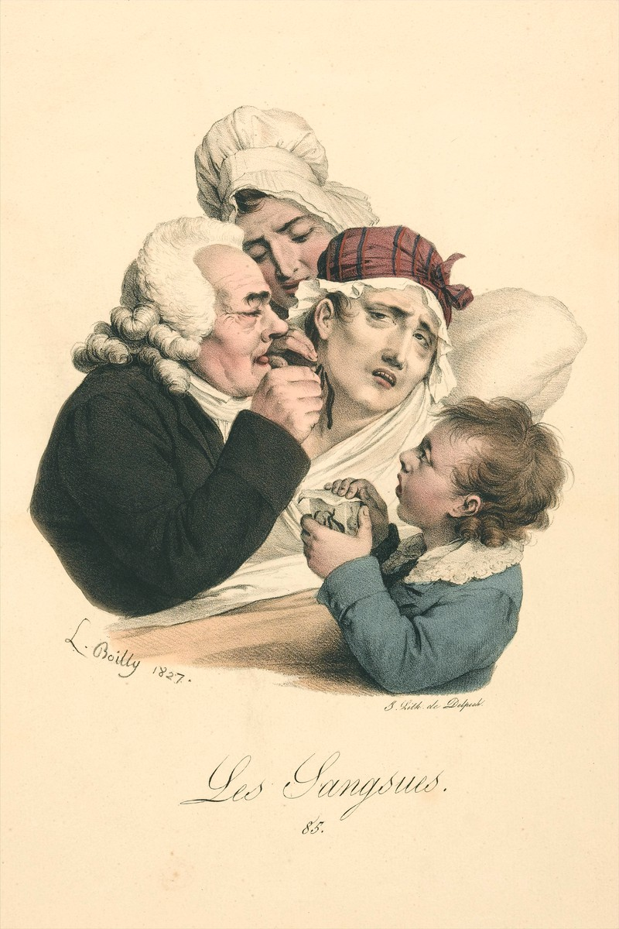
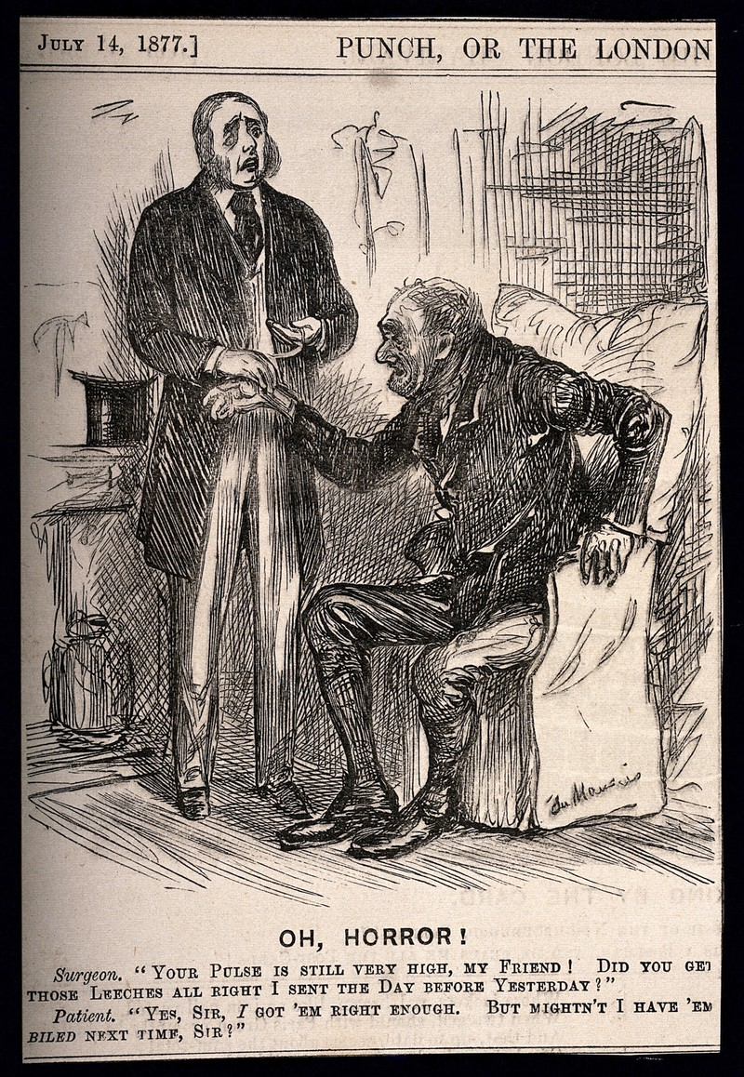
Source B
Misunderstanding between a doctor and his working-class patient, who has swallowed the leeches he prescribed. Wood engraving by G. Du Maurier, 1877.
Task:
Explain the use of leeches in medical history, refer to both sources.
Challenge:
Why do some medical treatments, like using leeches, come back into usage? Discuss.
Source A
A medical practitioner administers leeches to a patient. Colour lithograph after L. Boilly, 1827.

Slide 13
Plenary
Answer the quick questionnaire honestly.
Which fact surprised you the most and why? Write your answer on a post-it note.

Slide 14
Additional reading
http://news.bbc.co.uk/1/hi/health/3858087.stm - Leeches in modern medicine
http://sciencenetlinks.com/science-news/science-updates/modern-leeching/
https://www.theguardian.com/science/2015/apr/18/animal-lives-wasted-in-drugs-safety-tests
http://www.bbc.co.uk/ethics/animals/using/experiments_1.shtml
https://www.crueltyfreeinternational.org/why-we-do-it/facts-and-figures-animal-testing

Slide 16
Resources

Slide 17
Mind-boggling Medical History: Animals
Key term
Infect
Laboratory
Detect
Nut allergy sufferers
Leeches
Soft tissue
Detaching
Reconstructive
Maggots
Rabies
Wild Dogs
Valves
Tapeworms
Tranquilizers
Therapeutically
Definition
To unfasten, or disconnect something, and remove it.
Someone who has a (possibly life threatening) allergy to nuts/peanuts.
Body tissues that are not hardened, e.g. blood vessels, skin, muscles, etc.
A contagious and fatal disease found in dogs, causing madness and convulsions.
A room or building equipped for scientific experiments or research.
A wild member of the dog family, usually found in Africa, India or Australia.
Affect with a harmful or disease-causing organism.
To discover, or identify, the presence of something.
A flat worm that feeds off its host, lives in the intestines.
A worm with suckers at both ends. Many species are bloodsucking parasites.
Relating to the healing of a disease/ailment.
A medical drug taken to reduce anxiety, e.g. sedative.
Rebuilding something after it has been damaged or destroyed.
A tube in the heart that only allows blood to flow in one direction
A soft-bodied larva of a fly or other insect, found in decaying matter.

Slide 18
Glossary of medical terms – Answers!
Key term
Infect
Laboratory
Detect
Nut allergy sufferers
Leeches
Soft tissue
Detaching
Reconstructive
Maggots
Rabies
Wild Dogs
Valves
Tapeworms
Tranquilizers
Therapeutically
Definition
To unfasten, or disconnect something, and remove it.
Someone who has a (possibly life threatening) allergy to nuts/peanuts.
Body tissues that are not hardened, e.g. blood vessels, skin, muscles, etc.
A contagious and fatal disease found in dogs, causing madness and convulsions.
A room or building equipped for scientific experiments or research.
A wild member of the dog family, usually found in Africa, India or Australia.
Affect with a harmful or disease-causing organism.
To discover, or identify, the presence of something.
A flat worm that feeds off its host, lives in the intestines.
A worm with suckers at both ends. Many species are bloodsucking parasites.
Relating to the healing of a disease/ailment.
A medical drug taken to reduce anxiety, e.g. sedative.
Rebuilding something after it has been damaged or destroyed.
A tube in the heart that only allows blood to flow in one direction
A soft-bodied larva of a fly or other insect, found in decaying matter.

Slide 19
Pregnancy can be detected by injecting a woman’s urine into a frog or toad.
Cats are used therapeutically to detect cancerous growths
Humans can be infected with monkeypox, a disease first discovered in laboratory monkeys.
If a pregnant woman is scared by a wild dog it may cause her child to be born with excess hair.
Maggots are used in hospitals to clean infected wounds.
Tapeworms can be used to deliver tranquilizers speedily into the body.
Rabies is a mental condition caused by fear of wild dogs.
Leeches are used to prevent soft tissue from detaching from the face in reconstructive facial surgery.
Pig valves are commonly used in heart valve replacement due to the colour of the tissue. The pink-tinged valve is less likely to be rejected due to the similarity to human valves.
Pregnancy can be detected by injecting a woman’s urine into a frog or toad.

Slide 20
Present | Past | Fictional

Slide 21
Mind Boggling Medicine Questionnaire
1. How easy was it to understand the game’s instructions?
Very Hard Hard Average Easy Very Easy
2. How easy did you find the questions?
Very Hard Hard Average Easy Very Easy
3. How would you describe the experience of playing the game? You can circle as many of the words as you like.
4. How would you describe the language used in the game? Please select one word.
Confusing Academic Clear Engaging Simplistic
Other (Please specify here):
5. What did you like most about the game?
6. What didn’t you like about the game?
7. Would this game appeal to you? Y / N
Mind Boggling Medicine Questionnaire
1. How easy was it to understand the game’s instructions?
Very Hard Hard Average Easy Very Easy
2. How easy did you find the questions?
Very Hard Hard Average Easy Very Easy
3. How would you describe the experience of playing the game? You can circle as many of the words as you like.
4. How would you describe the language used in the game? Please select one word.
Confusing Academic Clear Engaging Simplistic
Other (Please specify here):
5. What did you like most about the game?
6. What didn’t you like about the game?
7. Would this game appeal to you? Y / N
Entertaining | Boring | Educational | Confusing
Upsetting | Fun | Uncomfortable | Engaging
Fascinating | Patronising | Inclusive | Unoriginal
Entertaining | Boring | Educational | Confusing
Upsetting | Fun | Uncomfortable | Engaging
Fascinating | Patronising | Inclusive | Unoriginal

