Slide 1
Mind-Boggling Medical History
Treatments – GCSE

Slide 2
 |  | Activity | Timings | Extension(s)
1 | Do now / starter | Match up the medical term to the definition | 5 | Challenge: consider why treatments might go out of usage in medicine.
2 | I do (explain) | Mind-boggling medical history – sorting the treatments into ‘Present’, ‘Past’ and completely ‘fictional’. | 5
3 | You do (paired/group/whole class) | Your choice: can be printed and sorted in pairs/small groups, or on the board and discussed as a class. | 10-15 | Challenge: students must justify their response(s) with logic and/or prior knowledge (e.g. I believe this is current practice because I read about someone with… or, this seems logically sound because garlic is supposed to be good for you, etc.)
4 | We do (discussion) | Teacher reads the information as each statement is revealed to be current, disproved or fictional – giving time for students to respond/query any that surprise them. | 10-15
5 | You do (task) | Look at the medical adverts and discuss how times/medicines have changed – can be printed out and annotated or used as discussion topic on board. Students to create their own medicine advert for one of the treatments looked at today. | 15-20
6 | Plenary | To complete the questionnaire and write down which fact surprised them the most and why. | 5
Timings are flexible where needed
e.g.
30 mins – 1, 2, 3, 4
40 mins – 1, 2, 3, 4, 6
60 mins – all

Slide 3
Mind-boggling Medical History: Treatments
Key term
Valves
Tapeworm
Faeces
Intestinal
Bile
Gallbladder
Revive
Saliva
Chronic
Semi-conscious
Coccyx
Morphine
Manipulate
Jaundice
Infinite
Potassium
Definition
Restore to life or consciousness
Relating, or affecting the intestines, in the digestive system
An illness that lasts a long time or keeps coming back
A small organ beneath the liver where bile is stored.
A small bone at the base of the spine, the tailbone
A worm that feeds off its host, lives in the intestines
A narcotic drug that comes from opium and is used in pain relief
To handle in a skilled manner
Poo! Excrement, waste, etc.
A mineral essential to a healthy diet
A bitter, green-brown fluid that helps digest food
A condition which causes yellowing of the skin
Limitless or endless, impossible to calculate
Watery liquid which fills the mouth to aid eating
A tube in the heart that only allows blood to flow in one direction
Only partly conscious/awake
Challenge: Why do treatments go out of fashion over time in medicine? Can you give any examples?

Slide 4
Glossary of medical terms – match up
Key term
Valves
Tapeworm
Faeces
Intestinal
Bile
Gallbladder
Revive
Saliva
Chronic
Semi-conscious
Coccyx
Morphine
Manipulate
Potassium
Infinite
Jaundice
Definition
Restore to life or consciousness
Relating, or affecting the intestines, in the digestive system
An illness that lasts a long time or keeps coming back.
A small organ beneath the liver where bile is stored
A small bone at the base of the spine, the tailbone
A worm that feeds off its host, lives in the intestines
A narcotic drug that comes from opium and is used in pain relief
To handle in a skilled manner
Poo! Excrement, waste, etc
A mineral essential to a healthy diet
A bitter, green-brown fluid that helps digest food
A condition which causes yellowing of the skin
Limitless or endless, impossible to calculate
Watery liquid which fills the mouth to aid eating
A tube in the heart that only allows blood to flow in one direction
Only partly conscious/awake

Slide 5
Over to you…
Present | Past | Fictional
The theory or practice is from modern-day medicine. It is believed to be true by most medical and healthcare practitioners or is in current use today. | The theory or practice is from the history of medicine. It was once believed to be true by some or all medical and healthcare practitioners. It is now thought to be factually incorrect or is no longer in use. | The theory or practice is entirely made up. As far as we know no-one has ever believed this theory or used this treatment.
Sort the different treatments into the 3 categories.
Do you think it is still being used (present)?
Or was once used in the past?
Or is utterly made up (fictional)?
Challenge: be ready to justify your answers!

Slide 6
Present | Past | Fictional
Snake venom is used to fight cancer.
Heroin is a non-addictive alternative for morphine used in children’s cough medicine.
If used wrongly, the universal antibiotic Kalocin can kill off all good bacteria in a person’s body, risking an infinite number of infections
Silver dressings are a good treatment for chronic ulcers and extensive burns.
Blowing tobacco smoke into the anus of a semi-conscious person will revive them.
In the absence of medical supplies, butter can be pasted around the edges of a wound to prevent bacteria from entering it.
A combination of onion, garlic and cow bile can help kill infections.
Hospitals place beds outside in all weathers to help ease symptoms of tuberculosis (TB).
The tailbone (coccyx) can be manipulated to make a person taller.
Faeces from healthy people mixed with water is given to treat patients suffering from intestinal infection.

Slide 7
Blowing tobacco smoke into the anus of a semi-conscious person will revive them.
Heroin is a non-addictive alternative for morphine used in children’s cough medicine.
The tailbone (coccyx) can be manipulated to make a person taller.
Silver dressings are a good treatment for chronic ulcers and extensive burns.
In the absence of medical supplies, butter can be pasted around the edges of a wound to prevent bacteria from entering it.
If used wrongly, the universal antibiotic Kalocin can kill off all good bacteria in a person’s body, risking an infinite number of infections
Faeces from healthy people mixed with water is given to treat patients suffering from intestinal infection.
A combination of onion, garlic and cow bile can help kill infections.
Hospitals place beds outside in all weathers to help ease symptoms of tuberculosis (TB).
Snake venom is used to fight cancer.

Slide 8
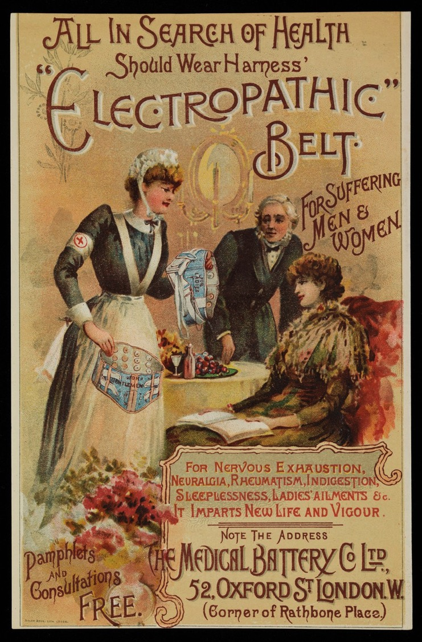
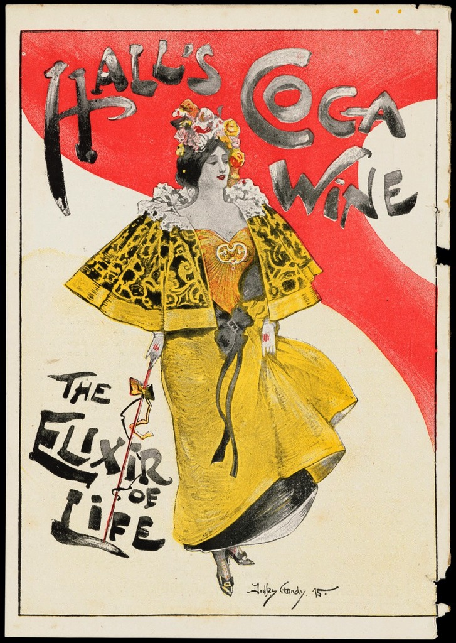
Look at these old medicine adverts.
What has changed today?
Has anything remained strangely similar?
Task: You are going to create your own ‘old-fashioned- medicine advert for one for the treatments we have looked at today. It can be any of them – but do consider your target audience!

Slide 9
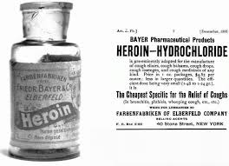
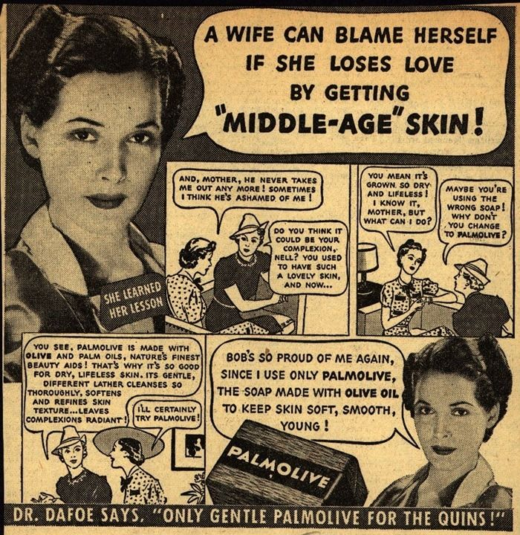
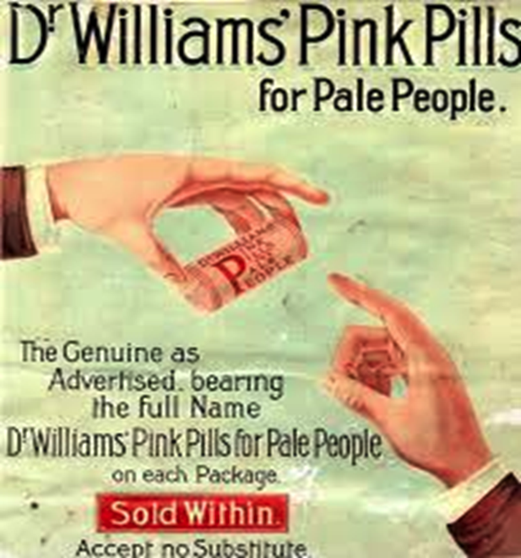
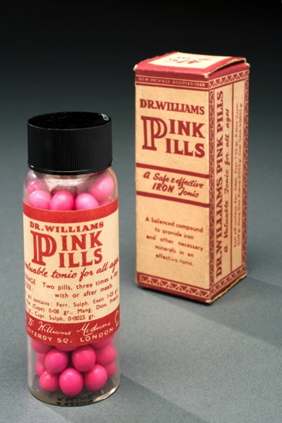
Heroin – healthy?
Pills to stop you being too pale?
Treatments to ensure you remain young?

Slide 10
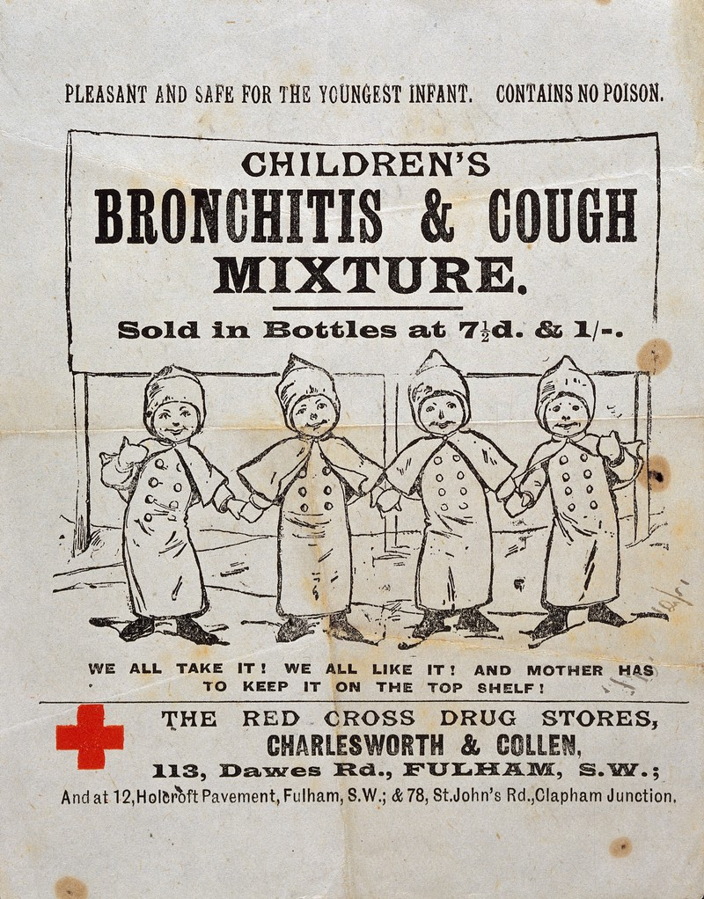
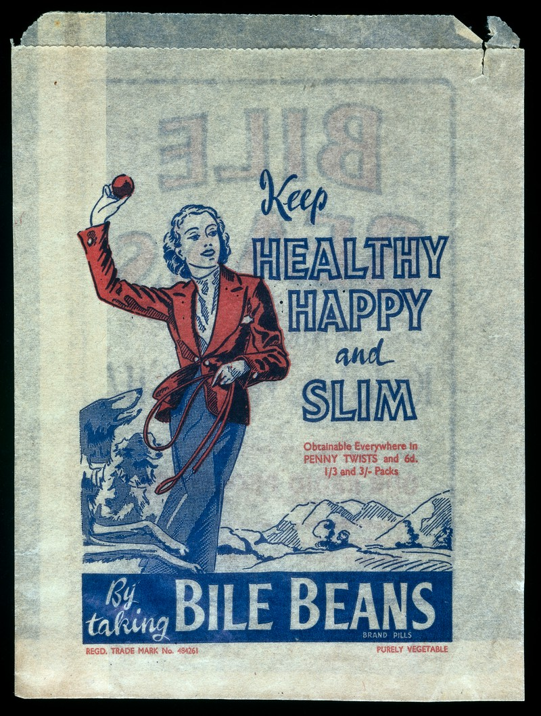

Slide 11
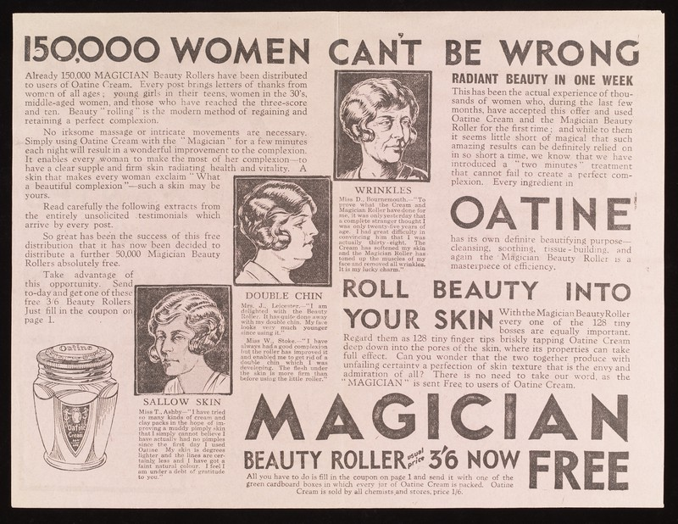

Slide 12
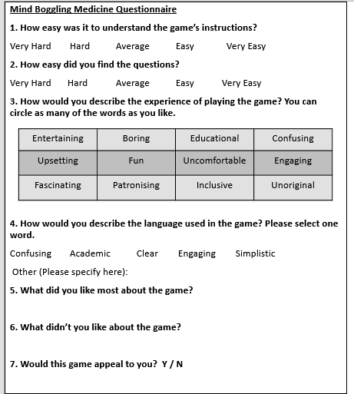
Plenary
Answer the quick questionnaire honestly.
Which fact surprised you the most and why? Write your answer on a post-it note.

Slide 14
Resources

Slide 15
Glossary of medical terms – match up
Key term
Valves
Tapeworm
Faeces
Intestinal
Bile
Gallbladder
Mucus
Saliva
Chronic
Semi-conscious
Decay
Morphine
Antimony
Purgative
Dilating
Dengue fever
Definition
A slimy substance, e.g. snot
Relating, or affecting the intestines, in the digestive system
An illness that lasts a long time or keeps coming back.
A small organ beneath the liver where bile is stored.
Rotting or decomposing
A worm that feeds off its host, lives in the intestines
A narcotic drug that comes from opium and is used in pain relief
A toxic white metallic element
Poo! Excrement, waste, etc.
A laxative, something that makes you physically vomit
A bitter, green-brown fluid that helps digest food
A tropical disease transmitted by mosquitoes
To make something bigger or wider
Watery liquid which fills the mouth to aid eating
A tube in the heart that only allows blood to flow in one direction
Only partly conscious/awake

Slide 16
Glossary of medical terms – Answers!
Key term
Valves
Tapeworm
Faeces
Intestinal
Bile
Gallbladder
Mucus
Saliva
Chronic
Semi-conscious
Decay
Morphine
Antimony
Purgative
Dilating
Dengue fever
Definition
A tube in the heart that only allows blood to flow in one direction
A worm that feeds off its host, lives in the intestines
Poo! Excrement, waste, etc.
Relating, or affecting the intestines, in the digestive system
A bitter, green-brown fluid that helps digest food
A small organ beneath the liver where bile is stored.
A slimy substance, e.g. snot
Watery liquid which fills the mouth to aid eating
An illness that lasts a long time or keeps coming back.
Only partly conscious/awake
Rotting or decomposing
A narcotic drug that comes from opium and is used in pain relief
A toxic white metallic element
A laxative, something that makes you physically vomit
To make something bigger or wider
A tropical disease transmitted by mosquitoes

Slide 17
Blowing tobacco smoke into the anus of a semi-conscious person will revive them.
Heroin is a non-addictive alternative for morphine used in children’s cough medicine.
The tailbone (coccyx) can be manipulated to make a person taller.
Silver dressings are a good treatment for chronic ulcers and extensive burns.
In the absence of medical supplies, butter can be pasted around the edges of a wound to prevent bacteria from entering it.
If used wrongly, the universal antibiotic Kalocin can kill off all good bacteria in a person’s body, risking an infinite number of infections
Faeces from healthy people mixed with water is given to treat patients suffering from intestinal infection.
A combination of onion, garlic and cow bile can help kill infections.
Hospitals place beds outside in all weathers to help ease symptoms of tuberculosis (TB).
Snake venom is used to fight cancer.

Slide 18
Present | Past | Fictional

Slide 19
Mind Boggling Medicine Questionnaire
1. How easy was it to understand the game’s instructions?
Very Hard Hard Average Easy Very Easy
2. How easy did you find the questions?
Very Hard Hard Average Easy Very Easy
3. How would you describe the experience of playing the game? You can circle as many of the words as you like.
4. How would you describe the language used in the game? Please select one word.
Confusing Academic Clear Engaging Simplistic
Other (Please specify here):
5. What did you like most about the game?
6. What didn’t you like about the game?
7. Would this game appeal to you? Y / N
Mind Boggling Medicine Questionnaire
1. How easy was it to understand the game’s instructions?
Very Hard Hard Average Easy Very Easy
2. How easy did you find the questions?
Very Hard Hard Average Easy Very Easy
3. How would you describe the experience of playing the game? You can circle as many of the words as you like.
4. How would you describe the language used in the game? Please select one word.
Confusing Academic Clear Engaging Simplistic
Other (Please specify here):
5. What did you like most about the game?
6. What didn’t you like about the game?
7. Would this game appeal to you? Y / N
Entertaining | Boring | Educational | Confusing
Upsetting | Fun | Uncomfortable | Engaging
Fascinating | Patronising | Inclusive | Unoriginal
Entertaining | Boring | Educational | Confusing
Upsetting | Fun | Uncomfortable | Engaging
Fascinating | Patronising | Inclusive | Unoriginal

